Slide 1
JavaServer Faces (JSF) Basics

Slide 2
JavaServer™ Faces (JSF)
A server side user interface component framework for Java™ technology-based web applications

Slide 3
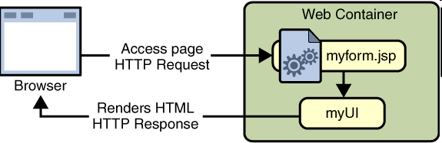
JSF

Slide 4
What is JSF?
A specification and reference implementation for a web application development framework
Components
Events
Validators
Back-end-data integration
Designed to be leveraged by tools
- Sun Java Studio Creator
JDeveloper
WSAD

Slide 5
Why JSF? (page 1)
MVC for web applications
Clean separation of roles
Easy to use
Extensible Component and Rendering architecture
Support for client device independence
Standard
Huge vendor and industry support

Slide 6
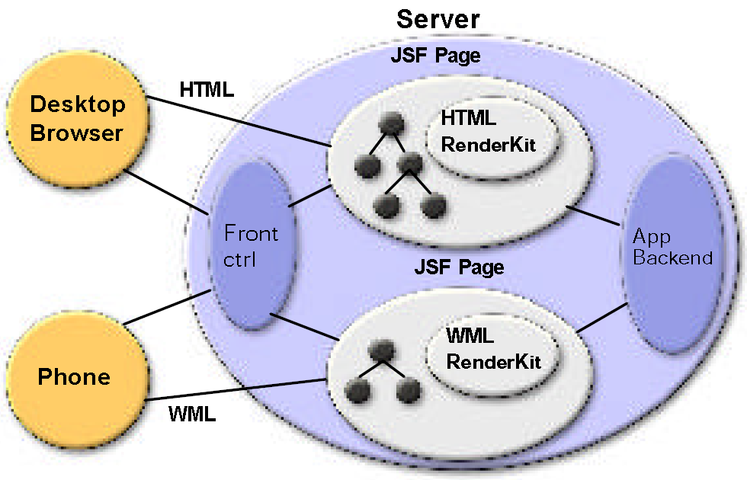
JSF Architecture

Slide 7
Important Basic Capabilities
Extensible UI component model
Flexible rendering model
Event handling model
Validation framework
Basic page navigation support
Internationalization
Accessibility

Slide 8
Key JSF Concepts
UIComponent
Render-independent characteristics
Base class with standard behaviors
Standard UIComponent Subclasses:
UICommand, UIForm, UIGraphic, UIInput,
UIOutput, UIPanel, UISelectBoolean,
UISelectMany, UISelectOne
FacesEvent
Base class for request and application events
Validator
Base class for standard and application defined validators

Slide 9
Key JSF Concepts
Converter
Plug-in for String-Object conversion
FacesContext – Per-Request State:
Servlet request, response, session
JSF request, response trees
JSF Expression Language
Model reference expression evaluators
Syntax similar to the expression language of the JSP Standard Tag Library (JSTL) 1.0
Primary interface between components and the data provided by (or to) the application

Slide 10
Key JSF Concepts
Renderer – Converts components to and from a specific markup language
Supports render-dependent attributes on components
May support more than one component typ
RenderKit – Library of Renderers
Extensible at runtime
Basic HTML RenderKit is part of the specification

Slide 11
Request Processing Life Cycle

Slide 12
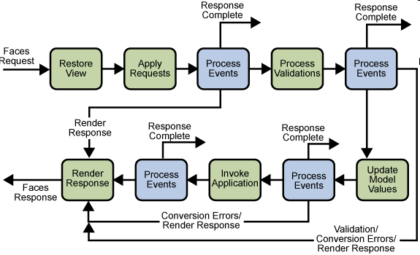
Life Cycle of a JSF page

Slide 13
UI Component Model

Slide 14
JSP Custom Tags in HTML Renderer Kit

Slide 15
Tags in HTML Renderer Kit
Each JSP custom tag defined in the standard HTML RenderKit class is composed of
component functionality, defined in the UIComponent class
rendering attributes, defined by the Renderer

Slide 16
Example Tags
<commandButton> & <commandLink> tags
“command” defines UI component
“Button” and “Link” defines rendering attribute

Slide 17
UI Component Model:
Conversion Model

Slide 18
Conversion Model
A component can be associated with server-side model object data
Two views of the component's data:
model view
presentation view
Component's data can be converted between the model view and the presentation view
This conversion is usually performed automatically by the component's renderer
Custom conversion is supported via Converter

Slide 19
UI Component Model:
Event & Listener Model

Slide 20
JSF Event & Listener Model
Similar to JavaBeans event model
Listener and Event classes that an application can use to handle events generated by UI components
An Event object identifies the component that generated the event and stores information about the event
To be notified of an event, an application must provide an implementation of the Listener class and register it on the component that generates the event
When the user activates a component, such as by clicking a button, an event is fired

Slide 21
UI Component Model:
Validation Model

Slide 22
Validation Model
Like the conversion model, the validation model defines a set of standard classes for performing common data validation checks
jsf-core tag library also defines a set of tags that correspond to the standard Validator implementations
Most of the tags have a set of attributes for configuring the validator's properties
minimum and maximum

Slide 23
ApplicationConfiguration

Slide 24
Application Configuration File
XML file for configuring resources required at application startup time
navigation rules, converters, validators, render kits
Usually named as faces-config.xml
A <faces-config> tag must enclose all of the other declarations
<faces-config>
....
</faces-config>

Slide 25
faces-config.xml
<?xml version="1.0"?>
<!DOCTYPE faces-config PUBLIC
"-//Sun Microsystems, Inc.//DTD JavaServer Faces Config 1.0//EN"
"http://java.sun.com/dtd/web-facesconfig_1_0.dtd">
<faces-config>
<application>
<locale-config>
<default-locale>en</default-locale>
<supported-locale>de</supported-locale>
<supported-locale>fr</supported-locale>
<supported-locale>es</supported-locale>
</locale-config>
</application>

Slide 26
faces-config.xml (2)
<navigation-rule>
...
<from-view-id>/greeting.jsp</from-view-id>
...
</navigation-rule>
<navigation-rule>
...
<from-view-id>/response.jsp</from-view-id>
...
</navigation-rule>
<managed-bean>
...
<managed-bean-name>UserNumberBean</managed-bean-name>
...
<managed-bean>
</faces-config>

Slide 27
Application Configuration File
You can have more than one application configuration file
There are three ways that you can make these files available to the application
A resource named /META-INF/faces-config.xml in any of the JAR files in the Web application's /WEB-INF/lib directory
A context init parameter, javax.faces.application
A resource named faces-config.xml in the /WEB-INF/ directory of your application (most common)

Slide 28
Getting Started with JSF

Slide 29
Creating a JSF Application

Slide 30
Requirement
A web Development Directory Structure
web.xml
JSF Specific Steps
Deployment

Slide 31
Development Directory Structure
Same development directory structure for any typical Web application
ContextRoot
/*.jsp files
/images/*.jpg,*.gif etc
/WEB-INF
/classes
/lib

Slide 32
Jar Files for JSF Application(1)
jsf-api.jar
– contains the javax.faces.* API classes
jsf-impl.jar
– contains the implementation classes of the JavaServer Faces standard implementation
jstl.jar
– required to use JSTL tags and referenced by JavaServer Faces standard implementation classes

Slide 33
*.jar files (2)
standard.jar
required to use JSTL tags and referenced by JavaServer Faces reference implementation classes
commons-beanutils.jar
utilities for defining and accessing JavaBeans component properties
commons-digester.jar
– for processing XML documents

Slide 34
*.jar files (3)
commons-collections.jar
– extensions of the Java 2 SDK Collections Framework
commons-logging.jar
– a general purpose, flexible logging facility to allow developers to instrument their code with logging statements

Slide 35
web.xml
Same structure as any other Web application
javax.faces.webapp.FacesServlet is like any other servlet
Servlet definition and mapping of FacesServlet
There are several JSF specific
<context-param> elements

Slide 36
Example web.xml
1 <web-app>
2 <display-name>Name of the application
3 </display-name>
4 <description>
5 Description for the Application
6 </description>
7
8 <context-param>
9 <param-name>javax.faces.STATE_SAVING_METHOD</param-name>
10 <param-value>client</param-value>
11 </context-param>
12
13 <context-param>
14 <param-name>javax.faces.application.CONFIG_FILES</param-name>
15 <param-value>/WEB-INF/faces-config.xml</param-value>
16 </context-param>
17
18 <context-param>
19 <param-name>com.sun.faces.validateXml</param-name>
20 <param-value>true</param-value>
21 </context-param>

Slide 37
Example web.xml(2)
22<listener>
23<listener-class>com.sun.faces.config.ConfigListener</listener-class>
</listener>
24<!-- Faces Servlet -->
25<servlet>
26 <servlet-name>Faces Servlet</servlet-name>
27 <servlet-class>javax.faces.webapp.FacesServlet</servlet-class>
28 <load-on-startup> 1 </load-on-startup>
29</servlet>
30 <!-- Faces Servlet Mapping -->
31 <servlet-mapping>
32<servlet-name>Faces Servlet</servlet-name>
33<url-pattern>*.faces</url-pattern>
34</servlet-mapping>
35</web-app>

Slide 38
JSF-Specific Development Steps
1.Create the Page
Using the UI component and core tags
2.Define Page Navigation
In the application configuration file
3. Deploy and Run
use tomcat web container

Slide 39
Two Tag Libraries
html basic
Defines tags for representing common HTML user interface components
jsf-core
Defines other JSF related tags
Independent of any rendering technology
JSP page need to declare them
<%@ taglib uri="http://java.sun.com/jsf/html/" prefix="h" %>
<%@ taglib uri="http://java.sun.com/jsf/core/" prefix="f" %>

Slide 40
Create the page (view.jsp)
<html>
<%@taglib uri="http://java.sun.com/jsf/html" prefix="h" %>
<%@ taglib uri="http://java.sun.com/jsf/core" prefix="f" %>
<head>
<title>My JSF 'index.jsp' starting page</title>
</head>
<body>
<f:view>
<h:outputText value="This is my JSF JSP page."/> <br>
<h:commandButton value=“go to next page” action=“next”/>
</f:view>
</body>
</html>

Slide 41
Create the page (welcome.jsp)
<html>
<%@taglib uri="http://java.sun.com/jsf/html" prefix="h" %>
<%@ taglib uri="http://java.sun.com/jsf/core" prefix="f" %>
<head>
<title>My JSF 'index.jsp' starting page</title>
</head>
<body>
<f:view>
<h:outputText value=“This is Welcome Page"/> <br>
</f:view>
</body>
</html>

Slide 42
Define Page Navigation
<!DOCTYPE faces-config PUBLIC
"-//Sun Microsystems, Inc.//DTD JavaServer Faces Config 1.1//EN"
"http://java.sun.com/dtd/web-facesconfig_1_1.dtd">
<faces-config>
<navigation-rule>
<from-view-id>/view.jsp</from-view-id>
<navigation-case>
<from-outcome>next</from-outcome>
<to-view-id>/welcome.jsp</to-view-id>
</navigation-case>
</navigation-rule>
</faces-config>

Slide 43
Deploy and Run the application
Start Tomcat
Copy the web aplication to <tomcat-home>/webapps
Access the JSF page using the url
http://localhost:8080/Context_root/view.faces

Slide 44
End

Slide 45
Application Class
When an application starts up, the JSF implementation creates a single instance of the Application class
Is automatically created for each application
FacesContext.getApplication()

Slide 46
Using JSF Tag Libraries

Slide 47
<f:view> element
Represents UIViewRoot component
All component tags on the page must be enclosed in the view tag
<f:view>
... other faces tags, possibly mixed with other
content ...
</f:view>
Optional locale attribute
Overrides the Locale stored in the UIViewRoot

Slide 48
Nested View's
Use <f:subview> element in order to include a JSF page inside another JSP page
<f:subview>
jsp:include page="theNestedPage.jsp"
<f:subview>

Slide 49
Using Core Tags

Slide 50
Event Handling Tags and Attributes
<f:actionListener> or actionListener attribute
Registers an action listener on a component
<f:valueChangeListener> or valueChangeListener attribute
Registers a value-change listener on a parent component

Slide 51
Example: <f:valueChangeListener>
<h:inputText id="firstName"
value="#{beanid.propertyName}“ required="true">
<f:valueChangeListener type=“id.methodToHandleTheListener" />
</h:inputText>

Slide 52
Example: actionListener attribute
<h:commandButton id=“id_1" action=“outCome“ value="#{bundle.propertyValue}"
actionListener="#{BeanId.actionMethod}">
</h:commandButton>

Slide 53
Attribute Configuration Tags
<f:attribute>
Adds configurable attributes to a parent components

Slide 54
Data Conversion Tags
<f:converter>
Registers an arbitrary converter on the parent component
<f:convertDateTime>
Registers a DateTime converter instance on the parent component
<f:convertNumber>
Registers a Number converter instance on the parent component

Slide 55
Facet Tag
<f:facet>
Signifies a nested component that has a special relationship to its enclosing tag

Slide 56
Parameter Substitution Tag
<f:parameter>
Substitutes parameters into a MessageFormat instance and to add query string name/value pairs to a URL

Slide 57
Tags for Representing Items in a List
<f:selectItem>
Represents one item in a list of items in a
UISelectOne or UISelectMany component <f:selectItems>
Represents a set of items in a UISelectOne or UISelectMany component

Slide 58
Container Tags
<f:subview>
Contains all JavaServer Faces tags in a page that is included in another JavaServer Faces page

Slide 59
Validator Tags
<f:validateDoubleRange>
Registers a DoubleRangeValidator on a component
<f:validateLength>
Registers a LengthValidator on a component
<f:validateLongRange>
Registers a LongRangeValidator on a component
<f:validator>
Registers a custom Validator on a component

Slide 60
Output Tags
<f:verbatim>
Generates a UIOutput component that gets its content from the body of this tag

Slide 61
Using HTML Tags

Slide 62
HTML Tags
Used to control display data or accept data from the user
Common attributes
id: uniquely identifies the component
value: identifies an external data source mapped to the component's value
binding: identifies a bean property mapped to the component instance

Slide 63
Using HTML Tags UIForm & <h:form>

Slide 64
UIForm & <h:form> tag
UIForm UI component
An input form with child components representing data that is either presented to the user or submitted with the form
Encloses all of the controls that display or collect data from the user
Include HTML markup to layout the controls on the page
<h:form> tag itself does not perform any layout

Slide 65
UICommand and <h:commandButton>

Slide 66
UICommand & <h:commandButton>
UICommand component performs an action when it is activated
Most common renderers are Button and Link

Slide 67
UICommand & <h:commandButton>
Additional attributes
action:
is either a logical outcome String or a JSF EL expression that points to a bean method that returns a logical outcome String
In either case, the logical outcome String is used by the navigation system to determine what page to access when the UICommand component is activated
actionListener:
is a JSF EL expression that points to a bean method that processes an ActionEvent fired by the UICommand component

Slide 68
Using HTML Tags UIInput & UIOutput

Slide 69
UIInput & UIOutput Components
UIInput component displays a value to a user and allows the user to modify this data
The most common example is a text field
UIOutput component displays data that cannot be modified
The most common example is a label
Conversions can occur
Both UIInput and UIOutput components can be rendered in several different ways

Slide 70
UIInput Component and Renderer Combinations
inputHidden
Allows a page author to include a hidden variable in a page
inputSecret
Accepts one line of text with no spaces and displays it as a set of asterisks as it is typed
inputText
Accepts a text string of one line
inputTextarea
Accepts multiple lines of text

Slide 71
UIOutput Component and Renderer Combinations
outputLabel
Displays a nested component as a label for a specified input field
outputLink
Display an <a href > tag that links to another page without generating an ActionEvent
outputMessage
Displays a localized message
outputText
Displays a text string of one line

Slide 72
Attributes of <h:inputText> and <h:outputText>
id
value
converter
validator
– JSF EL expression pointing to a backing-bean method that performs validation on the component's data
valueChangeListener
– a JSF EL expression that points to a backing- bean method that handles the event of entering a value in this component

Slide 73
<h:selectBooleanCheckbox>
Renders an HTML "input" element of type "checkbox"
<h:selectBooleanCheckbox title="emailUpdates" value="#{jsfexample.wantsEmailUpdates}" >

Slide 74
<h:selectManyCheckbox>
Render an HTML checkbox list
<h:selectManyCheckbox id="cars" value="#{carBean.car}"> <f:selectItems value="#{carBean.carList}"/>
<h:selectManyCheckbox>

Slide 75
<h:selectManyMenu>
Render an HTML option list (like a Combo box).
<h:selectManyMenu id="cars_selectManyMenu" value="#{carBean.car}"> <f:selectItems value="#{carBean.carList}"/>

Slide 76
Using HTML TagsUIPanel
<h:panelGrid> & <h:panelGroup>

Slide 77
UIPanel Component
Is used as a layout container for its children
Must have the number of rows predetermined

Slide 78
UIIPanelComponent and Renderer Combinations
panelGrid
Displays a HTML table
Used to display entire table
Render attributes are
columnClasses, columns, footerClass, headerClass, panelClass, rowClasses
panelGroup
Groups a set of components under one parent
Used to represent rows in the tables

Slide 79
Backing Bean (Model Object) Management

Slide 80
What are Backing Beans?
Server-side objects associated with UI components used in the page
Define UI component properties, each of which is bound to
a component's value or
a component instance
Can also define methods that perform functions associated with a component, which include validation, event handling, and navigation processing.

Slide 81
Why Backing Beans?
Separation of Model from View (MVC)
Model handles application logic and data: Backing Beans are Model objects
View handles presentation: UIcomponents

Slide 82
How to Specify Backing Beans in JSP page?
A page author uses the JavaServer Faces expression language (JSF EL) to bind a component's value or its instance to a backing bean property
JSF EL is in the form of "#{...}“
A page author also uses the JSF EL to refer to the backing-bean methods that perform processing for the component

Slide 83
Example: Binding Component Value to Backing Bean
<h:inputText id="userNo" value="#{beanId.beanProperty}“ validator="#{beanId.method}"/>

Slide 84
Page Navigation

Slide 85
Page Navigation
Application developer responsibility
Navigation rules are defined in the application configuration file
Navigation rules
Determine which page to go to after the user clicks a button or a hyperlink

Slide 86
Navigation Example
<navigation-rule>
<description>
The decision rule used by the NavigationHandler to
determine which view must be displayed after the
current view, is processed.
</description>
<from-view-id>/request.jsp</from-view-id>
<navigation-case>
<description>
</description>
<from-outcome>success</from-outcome>
<to-view-id>/response.jsp</to-view-id>
</navigation-case>
</navigation-rule>

Slide 87
Navigation Rule
<navigation-rule>
defines how to get from one page (specified in the from-tree-id element) to the other pages of the application
can contain any number of <navigation-case> elements
<navigation-case>
defines the page to open next (defined by to-tree-id) based on a logical outcome (defined by from-outcome)

Slide 88
Where can Outcome come from?
Outcome can be defined by the action attribute of the UICommand component that submits the form
“action” attribute can be a string or action method ( #{<BackingBean>.<Method>})
<h:commandButton id="submit“ action="success" label="Submit" />
<h:commandButton action="#{beanId.actionMethod}“ value="#{bundlw.key}" />

Slide 89
Thank You

